Slide 1


June 2020
MOSL Webinar on the Indian Economy: Monetary Policy and the Economy
Prof Alok Sheel
RBI Chair in Macroeconomics, ICRIER

Slide 2
The background to the Macroeconomic policy response to Covid 19
Although the Covid linked crisis is very different from the GFC a over a decade ago, the latter nevertheless provided policy makers with a ready made template for the macroeconomic policy response.
This template comprised aggressive use of both monetary and fiscal policy.
In fact so aggressive was the policy response in the wake of the GFC, that economists worried that there was little policy space left for another major crisis.
This crisis is now upon us.
The reason for this fear was that while stimulative policies ceased with the economic recovery, the stimulus could not be rolled back because the recovery was relatively weak, and to nowhere near to pre-crisis levels:
Central bank balance sheets remained bloated and policy rates just above ZLB
The sharp increase in public debt as a share of the National Income remained unchanged.

Slide 3
The differentiated policy response in the GFC
While EMEs could not escape the knockdown effect of what was essentially a financial crisis in advanced economies because of their overdependence on the latter for demand, their financial systems and economic growth by and large held up. They did not need to follow overly aggressive macroeconomic policies and exhaust their policy space.
This time around however they are as badly affected by the pandemic as advanced economies because the public health response in similar.
This has meant a sudden and sharp demand and supply shock in both AEs and EMEs. The fall in growth and employment is much sharper than during the GFC, and is being compared to the Great Depression of a century ago. Both the recovery, and the recovery path, whether Z shaped, V shaped or U shaped, is uncertain because the future trajectory of the pandemic remains a known unknown.

Slide 4
The differentiated policy response to Covid 19
While there is both aggressive monetary and fiscal policy response in AEs as during the GFC, there is far greater reliance on fiscal policy. Indeed the monetary policy response appears to be largely to accommodate aggressive fiscal policy which entails large amounts of public borrowing.
EMEs have so far baulked at a similarly aggressive fiscal response, relying more on monetary policy. They have also been wary of the new policy tools that conflate fiscal and monetary policies in what is coming to be termed the New Monetary theory, although may be changing with central banks of Brazil, Indonesia, Philippines, Colombia, Poland have started QE. India, as we shall see, started much earlier.
MMT: Elevated sovereign debt need not result in higher interest rates or inflation if the incremental public debt is held by publicly owned entities, including central banks. The excessive liquidity on account of weak private demand can be mopped up by central banks to purchase sovereign debt.
Large liquidity injections by central banks backstopping sovereign borrowing but also driving financial markets that are unfazed by the failing economy.

Slide 5
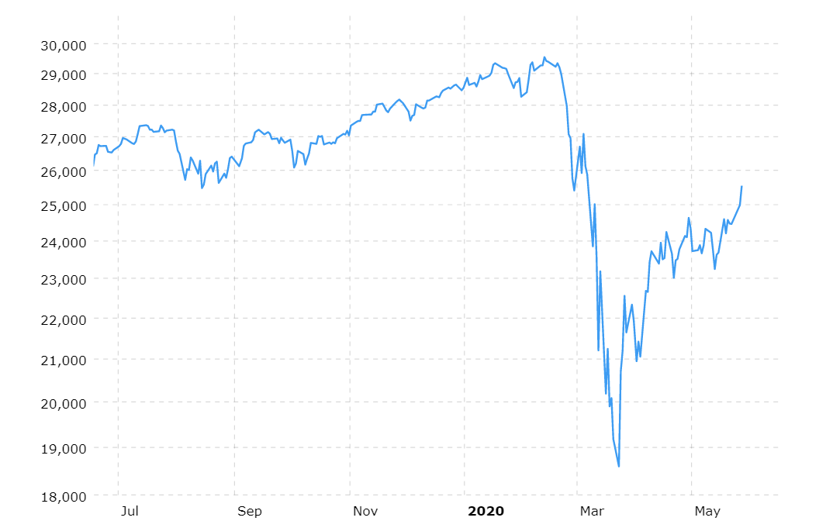
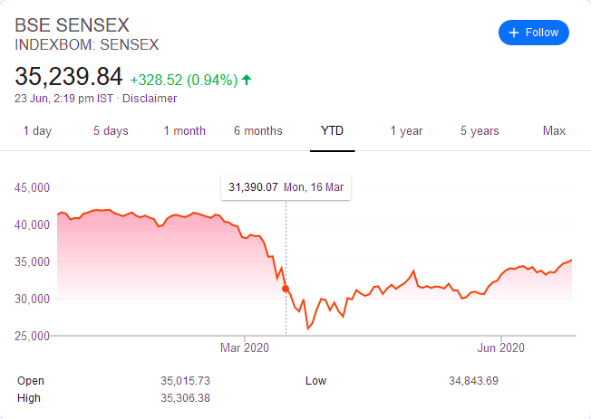
Financial Market Recovery
DJIA
Sensex

Slide 6
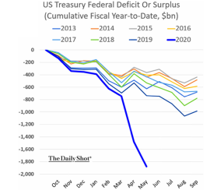
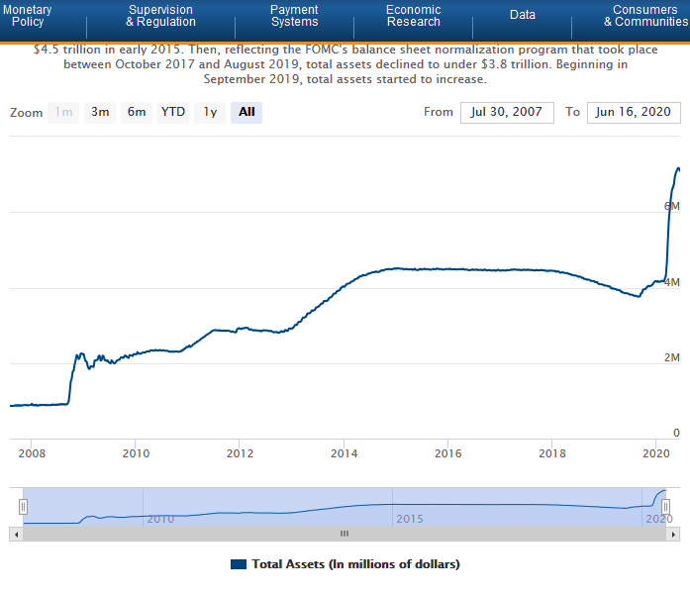
US Fiscal and Monetary Policy in Tandem

Slide 7
US Monetary policy during Covid 19
Conventional Monetary Policy
QE and MMT
Zero Lower Bound Interest rates.
Liquidity support through market intervention in overnight repo markets.
Targeted emergency lending to stressed institutions
Currency Swaps with other central banks in need of dollars.
Purchase of Long Term Treasury Bonds
Purchase of Mortgage Based Securities
Interest paid on Excess Bank Reserves parked with the Fed at a spread above the FFR (repo) rate. In conventional monetary policy (such as that of the RBI) the reverse repo rate is lower than the repo rate.

Slide 8
Atma Nirbhar Bharat Abhiyan Covid 19 Stimulus Package
India: 20 lakh Crores (10% of GDP)
US: $ 5 trillion (25% of GDP)
RBI Liquidity Injections (LTRO, OMO, CRR cut etc) 50% (5% of GDP)
Credit to MSMEs etc 25% (2.5% of GDP)
DBT, NREGA, Bank recap, Tax breaks, Health etc: 25% (2.5% of GDP)
Difficult to separate new commitments and frontloading of what is already budgeted.
No equivalent of the Paycheck Protection Programme (PPP) that comprises a major share (670 billion currently) of the US package
US Fed liquidity support : 40% (10% of GDP)
Treasury loans and credit guarantees: 20% (5% of GDP)
Direct Fiscal Support 40% (10% of GDP

Slide 9
Indian Monetary Policy During Covid 19
Liquidity support 5% of GDP
Repo rate lowered by 200 BP over the last 12 months, from 6% to 4%, and by 115 BP since March 2020.
Reduction in the real repo rate (using the average of CPI-WPI) has however been marginal.
Current real Repo at levels comparable with that 4-5 years ago? (YoY CPI March 2020: 5.8%; WPI May: 2020 -3.2%)
Administered small savings interest rates blunt transmission at the lower end.
Overhang of NPAs hinder transmission of lower rates to supply of bank lending.
Uncertainty in demand going forward constraining demand for credit.
Bank credit shrank by 1.1% between Dec 20, 2019 and June 5, 2020
Rupee securities held by RBI rose from Rs. 6.3 lakh crores in Dec 2017, to 8 lakh crores in Dec 2018, to 10 lakh crores in Dec 2019 and stood at 11.8 lakh crores as of June 5, 2020, doubling in just 2.5 years
 | Average repo rate | Average of WPI-CPI | Real repo rate
2003-04 | 7.0% | 4.6% | 2.4%
2004-05 | 6.0% | 5.2% | 0.8%
2005-06 | 6.1% | 4.4% | 1.8%
2006-07 | 7.0% | 5.6% | 1.4%
2007-08 | 7.8% | 5.5% | 2.2%
2008-09 | 7.3% | 8.5% | -1.2%
2009-10 | 4.8% | 8.1% | -3.3%
2010-11 | 5.9% | 9.9% | -4.0%
2011-12 | 8.0% | 8.7% | -0.7%
2012-13 | 8.0% | 8.4% | -0.4%
2013-14 | 7.5% | 7.4% | 0.2%
2014-15 | 7.9% | 3.6% | 4.3%
2015-16 | 7.0% | 0.6% | 6.4%
2016-17 | 6.4% | 3.1% | 3.3%
2017-18 | 6.1% | 3.3% | 2.8%
2018-19 | 6.3% | 3.8% | 2.5%
2019-20 | 5.4% | 3.3% | 2.2%

Slide 10
Bottomline
Unlike the GFC EMEs as badly affected as AEs by Covid 19.
EMEs have more policy space than AEs: Interest rates significantly above zero, public debt levels half that of AEs (India is an outlier), large FC reserves.
EME policy response has however been far more timid than AEs, perhaps wary of large-scale borrowing because of shallow domestic bond markets and market revolt. Central banks and financial systems consequently bearing disproportionate share of the burden at a time when demand and solvency are the underlying problems, not credit or liquidity. Private and corporate income has sharply contracted. Fiscal policy therefore needs to do the heavy lifting in both AEs and EMEs. Without aggressive fiscal support widespread misery likely, particularly in poorer South Asian countries like India.
Modern monetary theory open to EMEs also as central banks can purchase sovereign bonds beyond what their markets can absorb to contain a rise in interest rates. While this risks inflation, it is a risk worth taking in the warlike economic situation that prevails currently.
In the event of a deepening crisis, EMEs may have to borrow more and also make use of their large foreign currency safety nets and manage the consequences as best they can afterwards.

Slide 11
N O T E S

Slide 12
Motilal Oswal Securities Limited
M E M B E R O F B S E A N D N S E
Motilal Oswal Tower, Sayani Road, Prabhadevi, Mumbai 400 025, INDIA
BOARD: +91 22 3982 5500 | WEBSITE: www.motilaloswal.com
Explanation of Investment Rating
Investment Rating | Expected return (over 12-month)
BUY | >=15%
SELL | < - 10%
NEUTRAL | > - 10 % to 15%
UNDER REVIEW | Rating may undergo a change
NOT RATED | We have forward looking estimates for the stock but we refrain from assigning recommendation
*In case the recommendation given by the Research Analyst is inconsistent with the investment rating legend for a continuous period of 30 days,the Research Analyst shall within following 30 days take appropriate measures to make the recommendation consistent with the investment rating legend.
Disclosures:
The following Disclosures are being made in compliance with the SEBI Research Analyst Regulations 2014 (herein after referred to as the Regulations).
Motilal Oswal Financial Services Ltd. (MOFSL) is a SEBI Registered Research Analyst having registration no. INH000000412. MOFSL, the Research Entity (RE) as defined in the Regulations, is engaged in the business of providing Stock broking services, Investment Advisory Services, Depository participant services & distribution of various financial products. MOFSL is a subsidiary company of Passionate Investment Management Pvt. Ltd.. (PIMPL). MOFSL is a listed public company, the details in respect of which are available on www.motilaloswal.com. MOFSL (erstwhile Motilal Oswal Securities Limited - MOSL) is registered with the Securities & Exchange Board of India (SEBI) and is a registered Trading Member with National Stock Exchange of India Ltd. (NSE) and Bombay Stock Exchange Limited (BSE), Multi Commodity Exchange of India Limited (MCX) and National Commodity & Derivatives Exchange Limited (NCDEX) for its stock broking activities & is Depository participant with Central Depository Services Limited (CDSL) National Securities Depository Limited (NSDL),NERL, COMRIS and CCRL and is member of Association of Mutual Funds of India (AMFI) for distribution of financial products and Insurance Regulatory & Development Authority of India (IRDA) as Corporate Agent for insurance products. Details of associate entities of Motilal Oswal Financial Services Limited are available on the website at http://onlinereports.motilaloswal.com/Dormant/documents/Associate%20Details.pdf
Details of pending Enquiry Proceedings of Motilal Oswal Financial Services Limited are available on the website at https://galaxy.motilaloswal.com/ResearchAnalyst/PublishViewLitigation.aspx
MOFSL, it’s associates, Research Analyst or their relative may have any financial interest in the subject company. MOFSL and/or its associates and/or Research Analyst may have actual/beneficial ownership of 1% or more securities in the past 12 months. MOFSL and its associate company(ies), their directors and Research Analyst and their relatives may; (a) from time to time, have a long or short position in, act as principal in, and buy or sell the securities or derivatives thereof of companies mentioned herein. (b) be engaged in any other transaction involving such securities and earn brokerage or other compensation or act as a market maker in the financial instruments of the company(ies) discussed herein or act as an advisor or lender/borrower to such company(ies) or may have any other potential conflict of interests with respect to any recommendation and other related information and opinions.; however the same shall have no bearing whatsoever on the specific recommendations made by the analyst(s), as the recommendations made by the analyst(s) are completely independent of the views of the associates of MOFSL even though there might exist an inherent conflict of interest in some of the stocks mentioned in the research report. Research Analyst may have served as director/officer, etc. in the subject company in the past 12 months. MOFSL and/or its associates may have received any compensation from the subject company in the past 12 months.
In the past 12 months, MOFSL or any of its associates may have:
managed or co-managed public offering of securities from subject company of this research report,
received compensation for investment banking or merchant banking or brokerage services from subject company of this research report,
received compensation for products or services other than investment banking or merchant banking or brokerage services from the subject company of this research report.
Subject Company may have been a client of MOFSL or its associates in the past 12 months.
MOFSL and it’s associates have not received any compensation or other benefits from the subject company or third party in connection with the research report. To enhance transparency, MOFSL has incorporated a Disclosure of Interest Statement in this document. This should, however, not be treated as endorsement of the views expressed in the report. MOFSL and / or its affiliates do and seek to do business including investment banking with companies covered in its research reports. As a result, the recipients of this report should be aware that MOFSL may have a potential conflict of interest that may affect the objectivity of this report. Compensation of Research Analysts is not based on any specific merchant banking, investment banking or brokerage service transactions. Above disclosures include beneficial holdings lying in demat account of MOFSL which are opened for proprietary investments only. While calculating beneficial holdings, It does not consider demat accounts which are opened in name of MOFSL for other purposes (i.e holding client securities, collaterals, error trades etc.). MOFSL also earns DP income from clients which are not considered in above disclosures.

Slide 13
Terms & Conditions:
This report has been prepared by MOFSL and is meant for sole use by the recipient and not for circulation. The report and information contained herein is strictly confidential and may not be altered in any way, transmitted to, copied or distributed, in part or in whole, to any other person or to the media or reproduced in any form, without prior written consent of MOFSL. The report is based on the facts, figures and information that are considered true, correct, reliable and accurate. The intent of this report is not recommendatory in nature. The information is obtained from publicly available media or other sources believed to be reliable. Such information has not been independently verified and no guaranty, representation of warranty, express or implied, is made as to its accuracy, completeness or correctness. All such information and opinions are subject to change without notice. The report is prepared solely for informational purpose and does not constitute an offer document or solicitation of offer to buy or sell or subscribe for securities or other financial instruments for the clients. Though disseminated to all the customers simultaneously, not all customers may receive this report at the same time. MOFSL will not treat recipients as customers by virtue of their receiving this report.
Analyst Certification
The views expressed in this research report accurately reflect the personal views of the analyst(s) about the subject securities or issues, and no part of the compensation of the research analyst(s) was, is, or will be directly or indirectly related to the specific recommendations and views expressed by research analyst(s) in this report.
Disclosure of Interest Statement Companies where there is interest
Analyst ownership of the stock No
A graph of daily closing prices of securities is available at www.nseindia.com, www.bseindia.com. Research Analyst views on Subject Company may vary based on Fundamental research and Technical Research. Proprietary trading desk of MOFSL or its associates maintains arm’s length distance with Research Team as all the activities are segregated from MOFSL research activity and therefore it can have an independent view with regards to subject company for which Research Team have expressed their views.
Regional Disclosures (outside India)
This report is not directed or intended for distribution to or use by any person or entity resident in a state, country or any jurisdiction, where such distribution, publication, availability or use would be contrary to law, regulation or which would subject MOFSL & its group companies to registration or licensing requirements within such jurisdictions.
For Hong Kong:
This report is distributed in Hong Kong by Motilal Oswal capital Markets (Hong Kong) Private Limited, a licensed corporation (CE AYY-301) licensed and regulated by the Hong Kong Securities and Futures Commission (SFC) pursuant to the Securities and Futures Ordinance (Chapter 571 of the Laws of Hong Kong) “SFO”. As per SEBI (Research Analyst Regulations) 2014 Motilal Oswal Financial Services Limited(SEBI Reg No. INH000000412) has an agreement with Motilal Oswal capital Markets (Hong Kong) Private Limited for distribution of research report in Hong Kong. This report is intended for distribution only to “Professional Investors” as defined in Part I of Schedule 1 to SFO. Any investment or investment activity to which this document relates is only available to professional investor and will be engaged only with professional investors.” Nothing here is an offer or solicitation of these securities, products and services in any jurisdiction where their offer or sale is not qualified or exempt from registration. The Indian Analyst(s) who compile this report is/are not located in Hong Kong & are not conducting Research Analysis in Hong Kong.
For U.S:
Motilal Oswal Financial Services Limited (MOFSL) is not a registered broker - dealer under the U.S. Securities Exchange Act of 1934, as amended (the"1934 act") and under applicable state laws in the United States. In addition MOFSL is not a registered investment adviser under the U.S. Investment Advisers Act of 1940, as amended (the "Advisers Act" and together with the 1934 Act, the "Acts), and under applicable state laws in the United States. Accordingly, in the absence of specific exemption under the Acts, any brokerage and investment services provided by MOFSL, including the products and services described herein are not available to or intended for U.S. persons. This report is intended for distribution only to "Major Institutional Investors" as defined by Rule 15a-6(b)(4) of the Exchange Act and interpretations thereof by SEC (henceforth referred to as "major institutional investors"). This document must not be acted on or relied on by persons who are not major institutional investors. Any investment or investment activity to which this document relates is only available to major institutional investors and will be engaged in only with major institutional investors. In reliance on the exemption from registration provided by Rule 15a-6 of the U.S. Securities Exchange Act of 1934, as amended (the "Exchange Act") and interpretations thereof by the U.S. Securities and Exchange Commission ("SEC") in order to conduct business with Institutional Investors based in the U.S., MOFSL has entered into a chaperoning agreement with a U.S. registered broker-dealer, Motilal Oswal Securities International Private Limited. ("MOSIPL"). Any business interaction pursuant to this report will have to be executed within the provisions of this chaperoning agreement.
The Research Analysts contributing to the report may not be registered /qualified as research analyst with FINRA. Such research analyst may not be associated persons of the U.S. registered broker-dealer, MOSIPL, and therefore, may not be subject to NASD rule 2711 and NYSE Rule 472 restrictions on communication with a subject company, public appearances and trading securities held by a research analyst account.

Slide 14
For Singapore
In Singapore, this report is being distributed by Motilal Oswal Capital Markets Singapore Pte Ltd (“MOCMSPL”) (Co.Reg. NO. 201129401Z) which is a holder of a capital markets services license and an exempt financial adviser in Singapore,
as per the approved agreement under Paragraph 9 of Third Schedule of Securities and Futures Act (CAP 289) and Paragraph 11 of First Schedule of Financial Advisors Act (CAP 110) provided to MOCMSPL by Monetary Authority of Singapore. Persons in Singapore should contact MOCMSPL in respect of any matter arising from, or in connection with this report/publication/communication. This report is distributed solely to persons who qualify as “Institutional Investors”, of which some of whom may consist of "accredited" institutional investors as defined in section 4A(1) of the Securities and Futures Act, Chapter 289 of Singapore (“the SFA”). Accordingly, if a Singapore person is not or ceases to be such an institutional investor, such Singapore Person must immediately discontinue any use of this Report and inform MOCMSPL.
Disclaimer: The report and information contained herein is strictly confidential and meant solely for the selected recipient and may not be altered in any way, transmitted to, copied or distributed, in part or in whole, to any other person or to the media or reproduced in any form, without prior written consent. This report and information herein is solely for informational purpose and may not be used or considered as an offer document or solicitation of offer to buy or sell or subscribe for securities or other financial instruments. Nothing in this report constitutes investment, legal, accounting and tax advice or a representation that any investment or strategy is suitable or appropriate to your specific circumstances. The securities discussed and opinions expressed in this report may not be suitable for all investors, who must make their own investment decisions, based on their own investment objectives, financial positions and needs of specific recipient. This may not be taken in substitution for the exercise of independent judgment by any recipient. Each recipient of this document should make such investigations as it deems necessary to arrive at an independent evaluation of an investment in the securities of companies referred to in this document (including the merits and risks involved), and should consult its own advisors to determine the merits and risks of such an investment. The investment discussed or views expressed may not be suitable for all investors. Certain transactions -including those involving futures, options, another derivative products as well as non-investment grade securities - involve substantial risk and are not suitable for all investors. No representation or warranty, express or implied, is made as to the accuracy, completeness or fairness of the information and opinions contained in this document. The Disclosures of Interest Statement incorporated in this document is provided solely to enhance the transparency and should not be treated as endorsement of the views expressed in the report. This information is subject to change without any prior notice. The Company reserves the right to make modifications and alternations to this statement as may be required from time to time without any prior approval. MOFSL, its associates, their directors and the employees may from time to time, effect or have effected an own account transaction in, or deal as principal or agent in or for the securities mentioned in this document. They may perform or seek to perform investment banking or other services for, or solicit investment banking or other business from, any company referred to in this report. Each of these entities functions as a separate, distinct and independent of each other. The recipient should take this into account before interpreting the document. This report has been prepared on the basis of information that is already available in publicly accessible media or developed through analysis of MOFSL. The views expressed are those of the analyst, and the Company may or may not subscribe to all the views expressed therein. This document is being supplied to you solely for your information and may not be reproduced, redistributed or passed on, directly or indirectly, to any other person or published, copied, in whole or in part, for any purpose. This report is not directed or intended for distribution to, or use by, any person or entity who is a citizen or resident of or located in any locality, state, country or other jurisdiction, where such distribution, publication, availability or use would be contrary to law, regulation or which would subject MOFSL to any registration or licensing requirement within such jurisdiction. The securities described herein may or may not be eligible for sale in all jurisdictions or to certain category of investors. Persons in whose possession this document may come are required to inform themselves of and to observe such restriction. Neither the Firm, not its directors, employees, agents or representatives shall be liable for any damages whether direct or indirect, incidental, special or consequential including lost revenue or lost profits that may arise from or in connection with the use of the information. The person accessing this information specifically agrees to exempt MOFSL or any of its affiliates or employees from, any and all responsibility/liability arising from such misuse and agrees not to hold MOFSL or any of its affiliates or employees responsible for any such misuse and further agrees to hold MOFSL or any of its affiliates or employees free and harmless from all losses, costs, damages, expenses that may be suffered by the person accessing this information due to any errors and delays.
Registered Office Address: Motilal Oswal Tower, Rahimtullah Sayani Road, Opposite Parel ST Depot, Prabhadevi, Mumbai-400025; Tel No.: 022 71934200/ 022-71934263; Website www.motilaloswal.com.
CIN No.: L67190MH2005PLC153397.Correspondence Office Address: Palm Spring Centre, 2nd Floor, Palm Court Complex, New Link Road, Malad(West), Mumbai- 400 064. Tel No: 022 7188 1000.
Registration Nos.: Motilal Oswal Financial Services Limited (MOFSL)*: INZ000158836(BSE/NSE/MCX/NCDEX); CDSL and NSDL: IN-DP-16-2015; Research Analyst: INH000000412. AMFI: ARN - 146822; Investment Adviser: INA000007100; Insurance Corporate Agent: CA0579 ;PMS:INP000006712. Motilal Oswal Asset Management Company Ltd. (MOAMC): PMS (Registration No.: INP000000670); PMS and Mutual Funds are offered through MOAMC which is group company of MOFSL. Motilal Oswal Wealth Management Ltd. (MOWML): PMS (Registration No.: INP000004409) is offered through MOWML, which is a group company of MOFSL. Motilal Oswal Financial Services Limited is a distributor of Mutual Funds, PMS, Fixed Deposit, Bond, NCDs,Insurance Products and IPOs.Real Estate is offered through Motilal Oswal Real Estate Investment Advisors II Pvt. Ltd. which is a group company of MOFSL. Private Equity is offered through Motilal Oswal Private Equity Investment Advisors Pvt. Ltd which is a group company of MOFSL. Research & Advisory services is backed by proper research. Please read the Risk Disclosure Document prescribed by the Stock Exchanges carefully before investing. There is no assurance or guarantee of the returns. Investment in securities market is subject to market risk, read all the related documents carefully before investing. Details of Compliance Officer: Name: Neeraj Agarwal, Email ID: na@motilaloswal.com, Contact No.:022-71881085.
* MOSL has been amalgamated with Motilal Oswal Financial Services Limited (MOFSL) w.e.f August 21, 2018 pursuant to order dated July 30, 2018 issued by Hon'ble National Company Law Tribunal, Mumbai Bench.

